Slide 1

Home@theHeart
Wendy Williams
Assistant Director
Integrated Commissioning Children Families

Slide 2
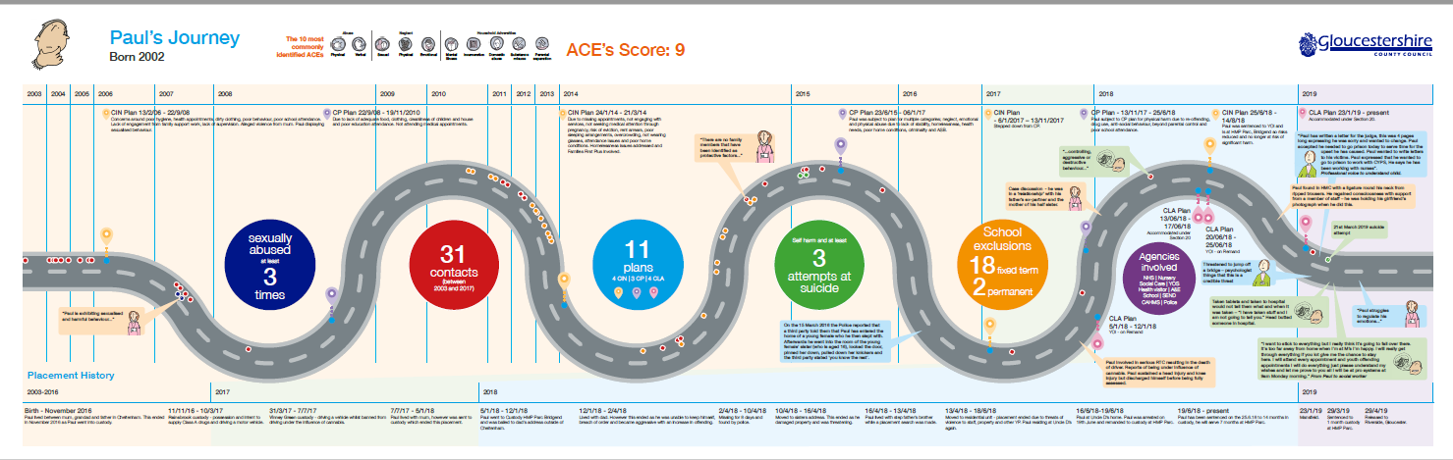
Challenge
Following an Ofsted Inspection in 2017, Gloucestershire County Council was rated ‘Inadequate’
To develop our Sufficiency Strategies, we asked our care experienced young people to share their journeys
They also told us what “good” looks like

Slide 3

We Listened
We Changed the narrative
We Influenced the market
We will have Trauma Informed Commissioning, and reduce transition points, so that trusted relationships can develop and thrive.
We will design and develop, with young people, a portfolio of homes that say, “No matter how complex you are, we want you to do well”.
“We will walk with you”, each young person will have the wrap around support and care they need to navigate their journey.

Slide 4

Trevone House
A forty bed older people home was transformed into:
  10 solo flats/studios
  4 two-bed flats
  2 well-being suites
  1 PACE/ emergency bed
  Communal Space
Minimum of 4 staff on duty 24/7 including an RMN
There are NO “sleeping in” staff
CQC registered provision and health qualified staff embedded in the management team
Continued involvement for up to 9yrs (ages 16 to 25yrs)

Slide 5

Outcomes
Reduction of missing episodes and hours resulting in a £250k saving of police time
No Tier 4 re-admissions
Deferred Secure Welfare for 2 young people
Decimalization of young people
A Stability rate of 90% - they come, and they stay ☺
100% GP registration and accessing of additional health services
64% in education or training

Slide 6

What Next - is the market ready for
Gloucestershire CC?
In the current conditions, it is very unlikely that the market will provide a sufficiency of good quality, local provision, without an active approach; whether by commissioning differently from the independent sector or developing new provision directly or through a new vehicle.
Gloucestershire County Council is undertaking an ‘options appraisal’, to set up its own company to deliver its sufficiency duty.

