Slide 1
Strategic Partnership approach to Re-imagining Residential Care
Liz Perfect – Head of Strategic Partnerships

Slide 2
The Problem
Commissioner:
Traditional procurement not providing flexibility for individual need
Local Authority budget pressures
Lack of innovation within the market
Rising number of looked after children being placed in out of authority placements
Neighbouring authorities utilising local beds leading to increased out of authority LAC
Perceived lack of market sufficiency
Lack of responsiveness to crisis interventions
Departmental/Organisational silo working
Lack of whole system thinking and integrated pathways of care
Capacity and resources to create innovation and system change
Provider:
Providers not bring engaged in the design of services/commissioning models
Lengthy commissioning processes with no guarantee of placements
Relationships not always developed to consider wider systems change
Lack of trust and shared risk
Recruitment and retention
Escalating costs
Missed opportunities for added value
Performance monitoring processes

Slide 3
Strategic Partnership Rationale
Ensures collaboration between two or more organisations
Offers the opportunity for purpose-alignment and ensure purpose-driven delivery, rather than profit-driven delivery.
Provides efficiencies, attracts additional resources and investment
Can produce improved outcomes, impact and quality for children and young people and their families.
Includes long and complex work to achieve culture change
Provides place-based localism and promotes flexibility being built into working relationships
Develops a culture of designing public/social value provision and planning for long-term infrastructure
Enables the integration of service stakeholders

Slide 4
Leicestershire Solution
Step 1
Procure a Childrens Innovation Partnership (CIP) to co-design, co-invest and co-deliver services
Step 2
Identify Design Brief opportunities for CIP Design Teams to design new service delivery models
Step 3
Develop a relational commissioing model in collaboration with providers
Develop a Strategic Partnership to:
Co-design, co-develop and co-deliver services
System change to improve outcomes
Offer co-investment in service design
Share new and emerging best practise
Walk alongside Children’s Services on the Journey to Excellence
Research local, national and international best practise models
Ensure services are designed and delivered to offer best quality and price
Develop a culture of transparency, trust, shared values and innovation
Whole system commissioning

Slide 5
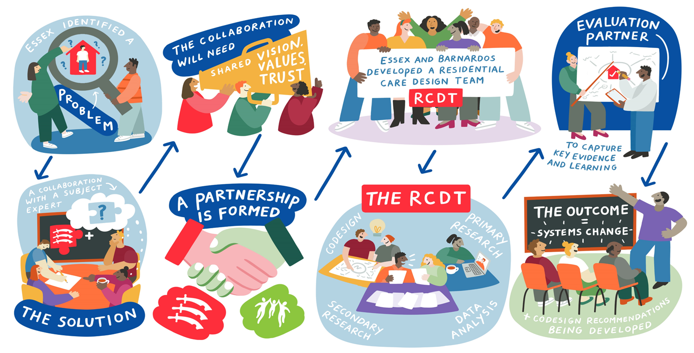
Essex Solution

Slide 6
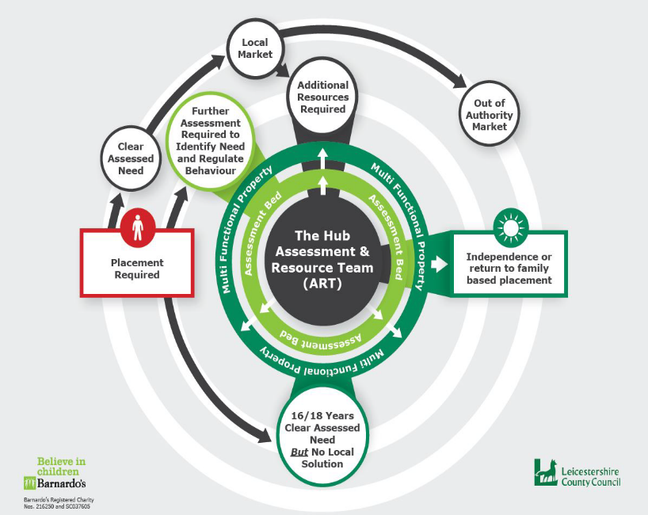
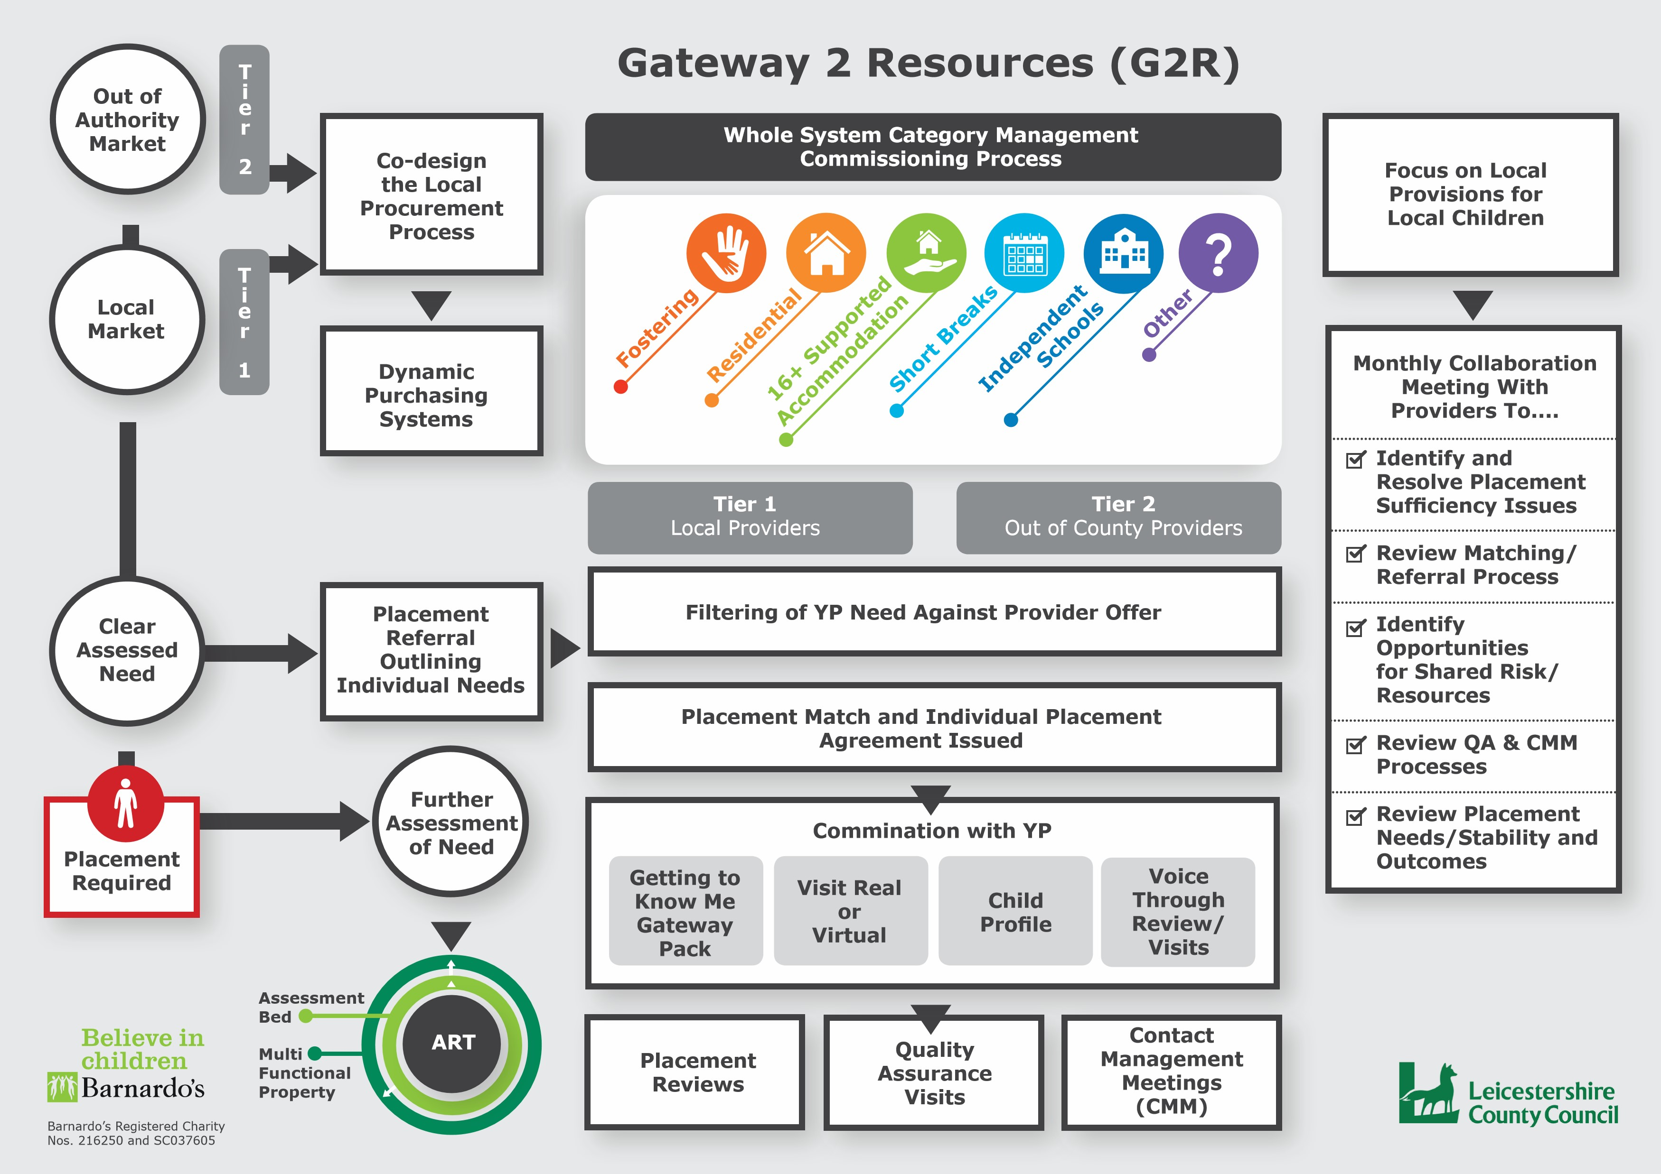
Leicestershire Impact
The first design brief signed off and includes an initial £2.5million capital investment
Relational Commissioning Model adopted for the Looked After Children Placements procurement
Successful award of c£1.9 million external funding through joint bids

Slide 7
Takeaway Messages
Collaborate with Partners to co-design, co-produce and co-deliver services
Children and Young People voice and lived experience is critical when co-designing new ways of working
Professionalise the workforce through the development of a Training Academy
Embed a whole system approach to researching & designing an integrated needs led local service offer
Develop a shared ambition for GM CYP which focuses on transformation, shared risk and shared resources
Develop trusted relationships with providers focused on shared values, vision, transparency

Slide 8
